Slide 1


Power BI Business Analytics
Dashboard Development Report
Customer Purchasing Behaviour Analysis Using Microsoft Power BI
Prepared by: Mohamed Heriyanto Bin Jamal Mohamed
MARKET ANALYSIS
Business Analytics Capstone Project
14 August 2026

Slide 2
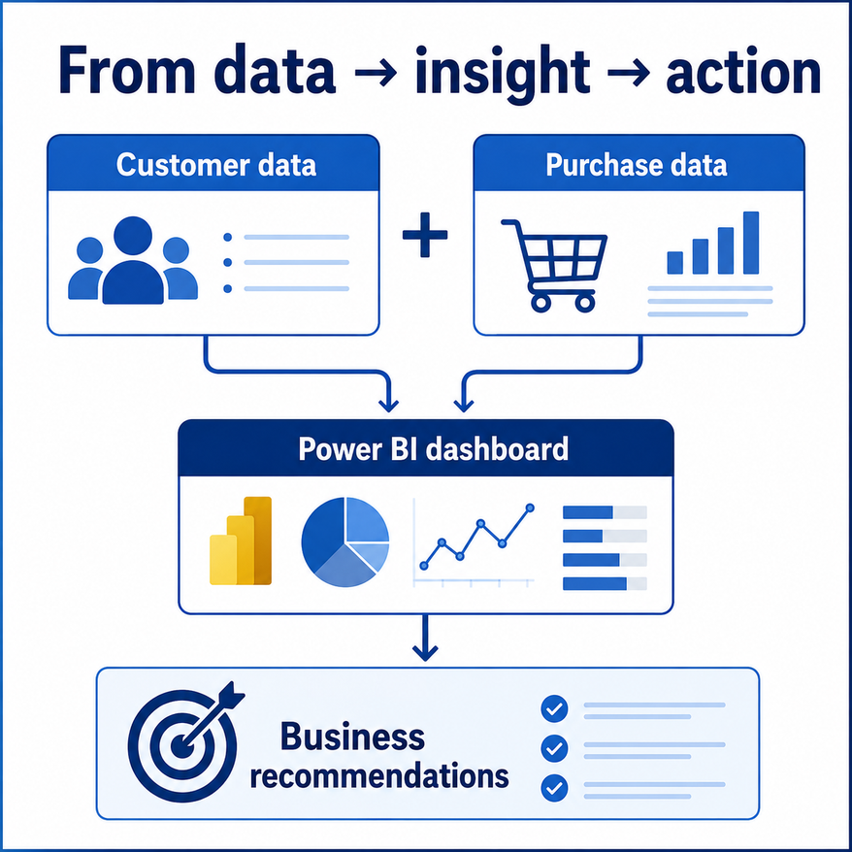
Business Problem and Analytical Need
Why a dashboard was required
Business challenge: Customer and sales data are available, but insights are difficult to see in raw tables
Decision need: Management needs to know which customers, countries, products and months drive performance
Dashboard role: Power BI converts disconnected data into a structured, interactive business intelligence view
Value: Faster decision making, improved customer targeting and clearer product strategy
Mohamed Heriyanto Bin Jamal Mohamed - Power BI Business Analytics Capstone Project

Slide 3
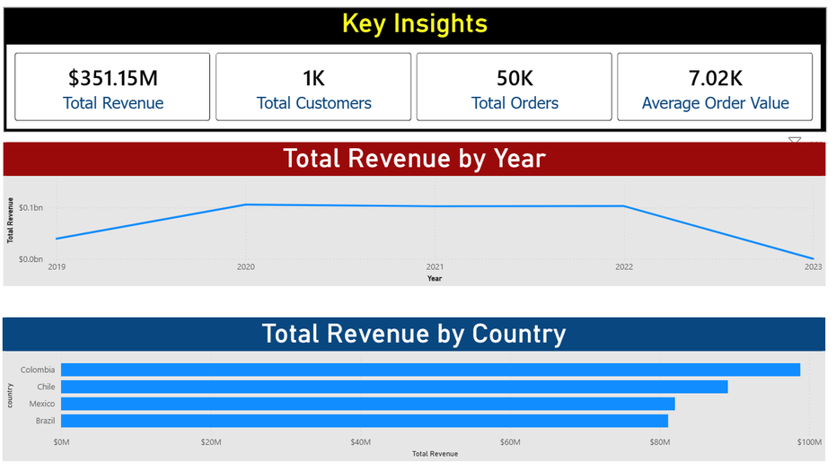
Executive Summary
A professional Power BI dashboard to support customer, product and sales decisions
Purpose: Turn raw customer and purchase data into interactive business insights
Method: Use Power BI data modelling, DAX measures, calculated columns and dashboard visuals
Scope: Analyse customer demographics, product performance, sales trends and key segments
Outcome: Provide recommendations for customer targeting, product focus and sales planning
The dashboard is designed for management users: quick KPIs at the top, detailed analysis pages underneath, and slicers for interactive filtering.
Mohamed Heriyanto Bin Jamal Mohamed - Power BI Business Analytics Capstone Project

Slide 4
Research Objectives
The dashboard was designed around five business analytics objectives
01
Analyse purchasing patterns by age, gender, country and income.
02
Identify products with the highest sales revenue and purchase volume.
03
Examine sales trends over time and identify peak purchasing periods.
04
Evaluate customer segments that contribute the highest revenue and customer value.
05
Provide business recommendations to improve sales, targeting and marketing strategy.
Mohamed Heriyanto Bin Jamal Mohamed - Power BI Business Analytics Capstone Project

Slide 5
Development Process
How the Power BI project was rebuilt and structured
1
Import data
Load Customer and Purchase files into Power BI Desktop
2
Clean data
Check data types, date columns, missing values and duplicates
3
Model data
Create Customer → Purchase relationship using customer_id
4
Create logic
Build DAX measures and calculated columns
5
Design dashboard
Build pages, charts, slicers and consistent formatting
6
Validate output
Test filters, verify KPIs and refine visuals
Mohamed Heriyanto Bin Jamal Mohamed - Power BI Business Analytics Capstone Project

Slide 6
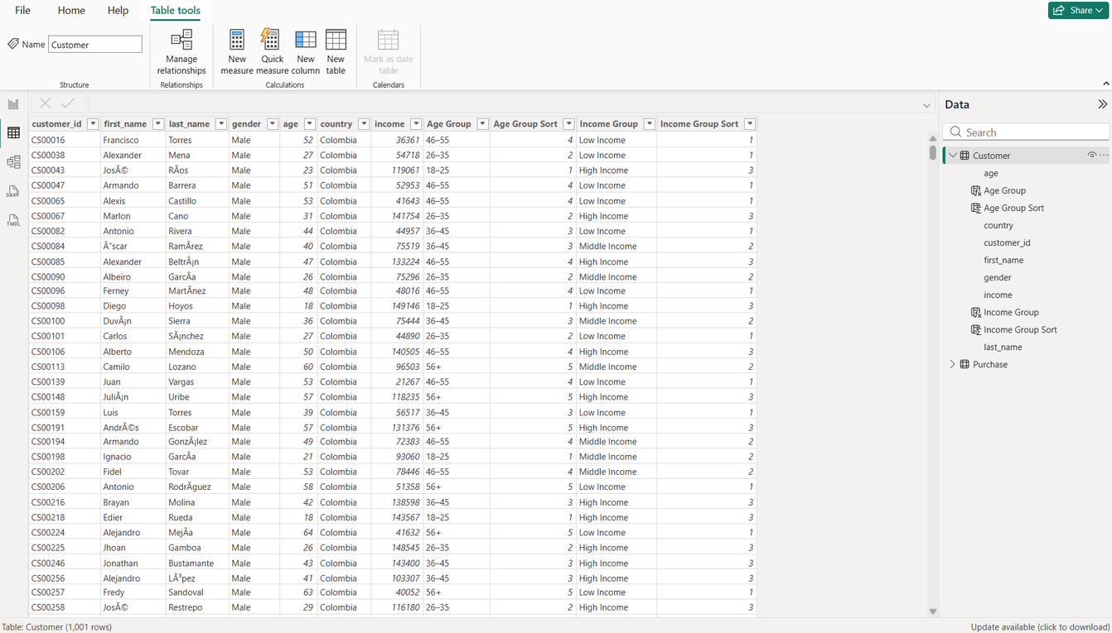
Data Preparation Evidence: Customer Table
Customer profile table used for demographic segmentation
Transformation performed
Customer fields include customer_id, gender, age, country and income.
Age Group was created to compare purchasing behaviour across meaningful age segments.
Income Group was created to classify customers into low, middle and high income segments.
Sort columns were added so categories appear in a logical order on charts and slicers.
Business purpose
The Customer table allows revenue and order behaviour to be analysed by demographics.
This supports customer targeting, segmentation and market focus decisions.
Mohamed Heriyanto Bin Jamal Mohamed - Power BI Business Analytics Capstone Project

Slide 7
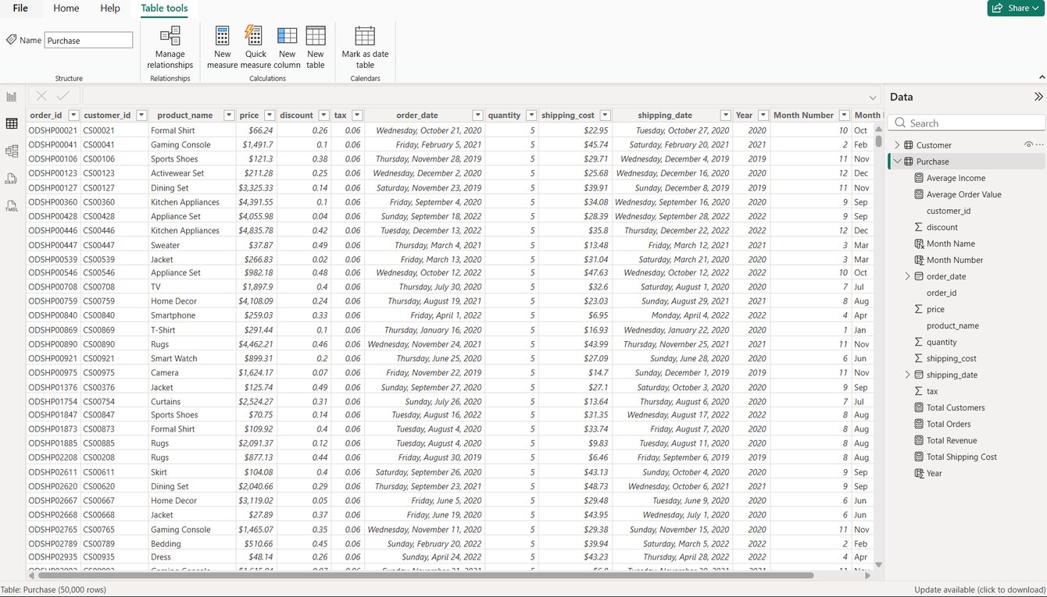
Data Preparation Evidence: Purchase Table
Transaction table used for product, order and sales analysis
What was checked
50,000 purchase records were loaded into Power BI.
Key transaction fields include order_id, customer_id, product_name, price, quantity, discount, tax and order_date.
Date, numeric and currency fields were reviewed to support accurate trend and revenue analysis.
Year, Month Name and Month Number were created to support monthly and yearly reporting.
Why this matters
The Purchase table is the fact table for sales performance.
It powers visuals such as revenue by month, orders by month, top products and total revenue KPIs.
Correct data types prevent sorting and calculation errors in Power BI.
Mohamed Heriyanto Bin Jamal Mohamed - Power BI Business Analytics Capstone Project

Slide 8
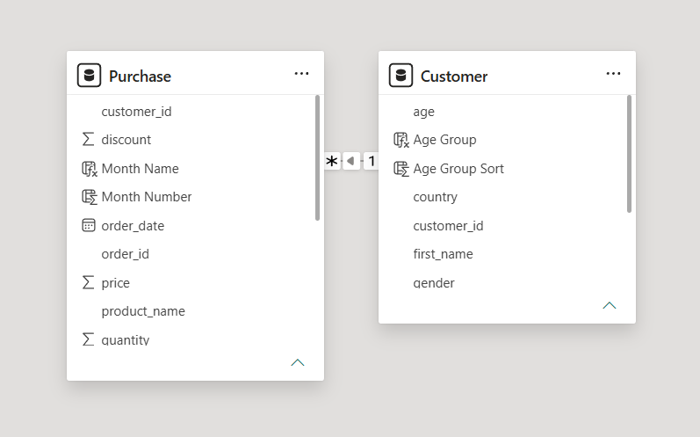
Data Model Relationship
Customer and Purchase linked using customer_id
Relationship logic
Customer contains one row per customer.
Purchase contains many purchase records per customer.
Relationship: Customer[customer_id] 1 → * Purchase[customer_id].
This allows demographics to filter purchase transactions correctly.
Why it matters for visuals
Demographic revenue charts depend on this relationship.
Slicers work because filters flow from Customer to Purchase.
A clean model reduces calculation and filtering errors.
Mohamed Heriyanto Bin Jamal Mohamed - Power BI Business Analytics Capstone Project

Slide 9
Data Cleaning and Transformation Summary
06D
Evidence supporting the trainer checklist
Data type validation
Feature engineering
order_date and shipping_date set as Date fields
price, quantity, discount, tax and shipping cost checked as numeric fields
Created Age Group and Income Group for customer segmentation
Created Year, Month Name and Month Number for trend analysis
Data modelling
Dashboard validation
Customer and Purchase linked by customer_id
One-to-many relationship supports demographic sales analysis
KPIs and charts tested with slicers
Month Name sorted by Month Number to avoid alphabetical month order
Key message: The dashboard was built from cleaned, transformed and modelled data — not from raw tables alone.
Mohamed Heriyanto Bin Jamal Mohamed - Power BI Business Analytics Capstone Project

Slide 10
DAX Measures Created
Measures calculate results dynamically based on slicer selections
Total Revenue: Main performance metric used across executive, product and trend pages
Total Orders: Counts purchase activity and supports order trend analysis
Total Customers: Measures the size of customer base after filtering
Average Order Value: Shows average spending per order and supports customer value analysis
Why measures?
Measures respond automatically to slicers.
They avoid storing unnecessary calculated values in every row.
They allow the same metric to be reused across multiple visuals.
They are standard practice in Power BI reporting.
Mohamed Heriyanto Bin Jamal Mohamed - Power BI Business Analytics Capstone Project

Slide 11
Calculated Columns Created
Columns were used for grouping and sorting categorical analysis
Age Group: Groups customers into meaningful age segments for comparison
Age Group Sort: Ensures age groups appear in logical order
Income Group: Segments customers into low, middle and high income categories
Income Group Sort: Ensures income groups appear from low to high
Year, Month Name, Month Number: Supports time-based trend analysis and correct month ordering
Why columns here?
Calculated columns are appropriate when a value is attached to each row, such as a customer age group or order month. They are then used as chart categories and slicer fields.
Mohamed Heriyanto Bin Jamal Mohamed - Power BI Business Analytics Capstone Project

Slide 12
Visual Selection Principles
Each chart was selected for a specific analytical purpose
KPI cards
quick management summary
Line charts
trends over time
Bar charts
ranking and readable category labels
Column charts
category comparison
Donut chart
simple proportion comparison
Slicers
interactive self-service filtering
The goal was not to use many different chart types, but to choose visuals that make the business question easy to answer.
Mohamed Heriyanto Bin Jamal Mohamed - Power BI Business Analytics Capstone Project

Slide 13
[Model relationships were done and then visuals were created as follows]
DASHBOARD PAGE 1
Executive Dashboard
Key Insights
10

Slide 14
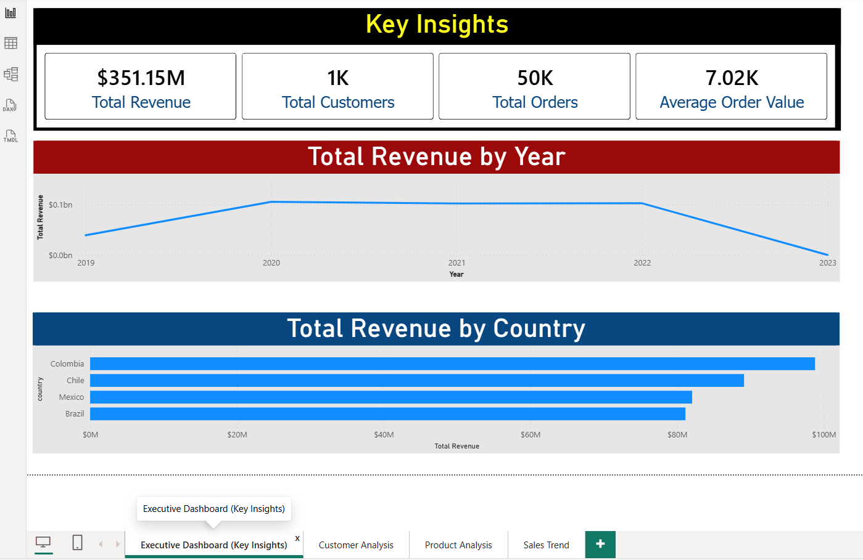
Executive Dashboard Overview
A one-page management summary of revenue, customers, orders and country performance
Mohamed Heriyanto Bin Jamal Mohamed - Power BI Business Analytics Capstone Project

Slide 15
KPI Cards: Fast Management Summary
Why cards were used at the top of the dashboard
Chart type: KPI Cards
Why selected: Executives need the main business figures immediately before reviewing detailed charts
Metrics shown: Total Revenue, Total Customers, Total Orders and Average Order Value
Business value: provides a quick health check of overall business performance
Mohamed Heriyanto Bin Jamal Mohamed - Power BI Business Analytics Capstone Project

Slide 16
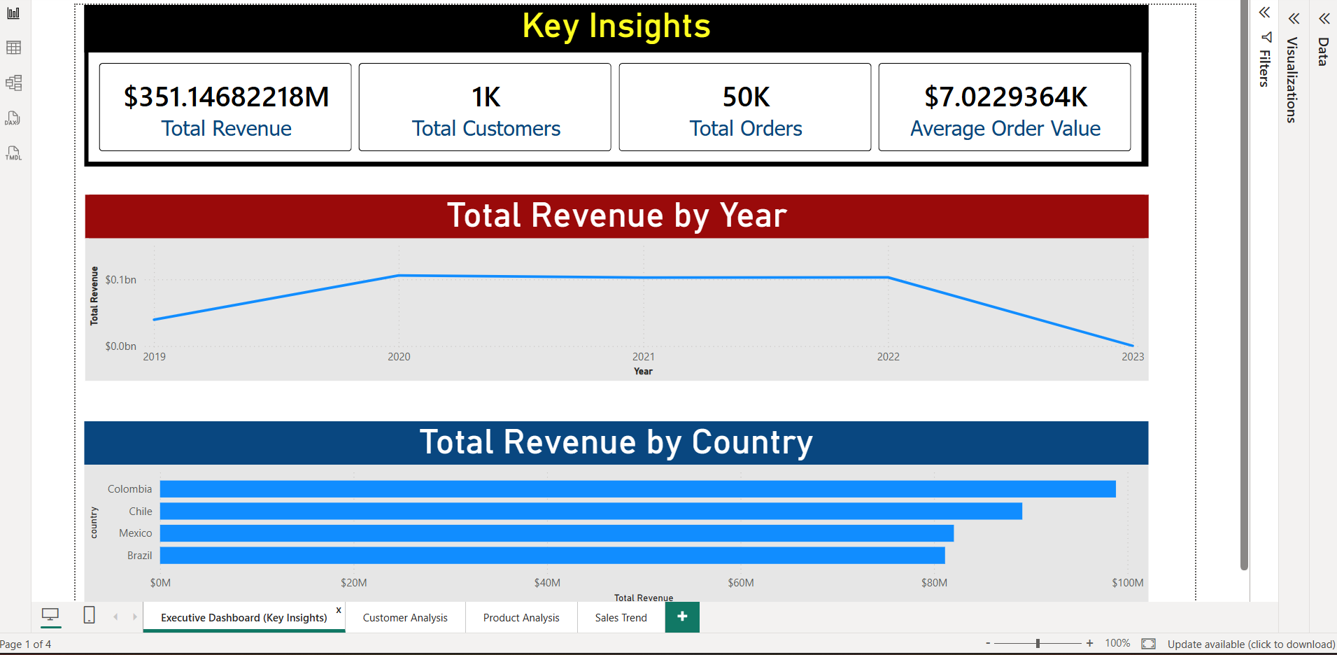
Total Revenue by Year
Line chart selected for yearly trend analysis
Chart type: Line Chart
Reason: Line charts are best for showing changes over time and making increases or decreases visible
Insight focus: Helps management see whether yearly revenue is growing, stable or declining
This visual supports trend monitoring and long-term planning.
Mohamed Heriyanto Bin Jamal Mohamed - Power BI Business Analytics Capstone Project

Slide 17
Total Revenue by Country
Horizontal bar chart selected for market comparison
Chart type: Clustered Bar Chart
Reason: Country names are easier to read horizontally and bars make ranking clear
Insight focus: Identifies which countries generate the strongest revenue contribution
Business use: Supports country-level marketing and resource allocation decisions
Mohamed Heriyanto Bin Jamal Mohamed - Power BI Business Analytics Capstone Project

Slide 18
DASHBOARD PAGE 2
Customer Analysis
Demographics and Segments

Slide 19
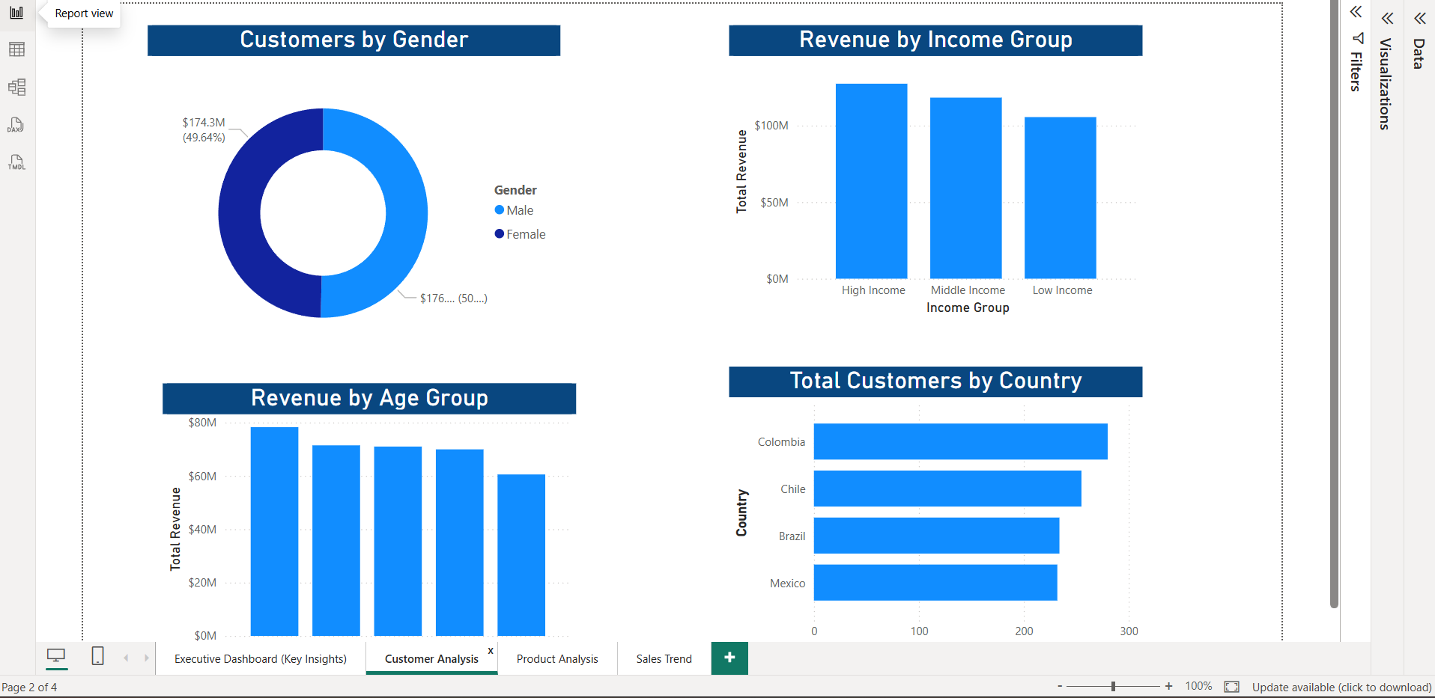
Customer Analysis Overview
Designed to answer Objective 1 and Objective 4
Mohamed Heriyanto Bin Jamal Mohamed - Power BI Business Analytics Capstone Project

Slide 20
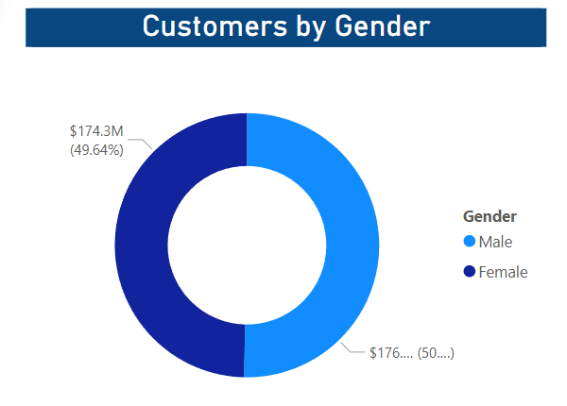
Customers by Gender
Donut chart selected for a simple proportional comparison
Chart type: Donut Chart
Reason: Gender has few categories, so a donut chart clearly shows the share of each group
Mohamed Heriyanto Bin Jamal Mohamed - Power BI Business Analytics Capstone Project

Slide 21
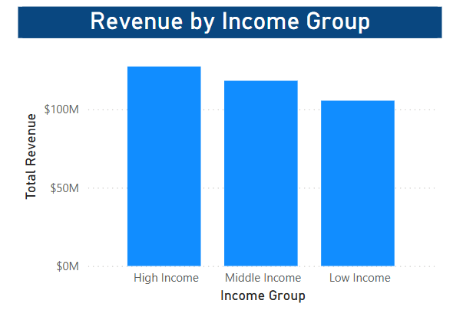
Revenue by Income Group
Column chart selected for segment comparison
Chart type: Clustered Column Chart
Reason: It clearly compares revenue generated by Low, Middle and High Income groups
This chart supports premium targeting, loyalty strategy and segment-specific promotions
Mohamed Heriyanto Bin Jamal Mohamed - Power BI Business Analytics Capstone Project

Slide 22
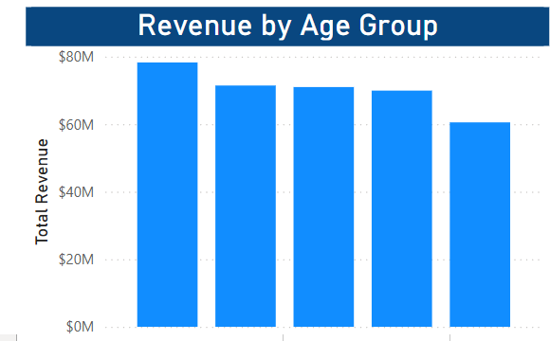
Revenue by Age Group
Column chart selected for customer lifecycle comparison
Chart type: Clustered Column Chart
Reason: Age groups are discrete categories that are easy to compare using vertical bars
Business value: Supports age-based marketing messages, product offers and customer retention campaigns
Mohamed Heriyanto Bin Jamal Mohamed - Power BI Business Analytics Capstone Project

Slide 23
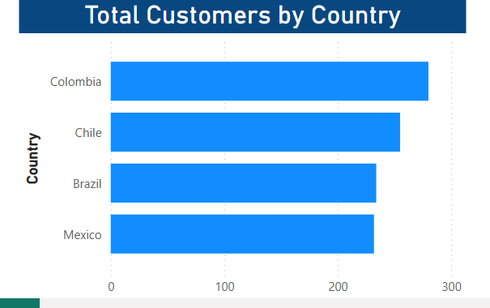
Total Customers by Country
Horizontal bar chart selected for customer base comparison
Chart type: Clustered Bar Chart
Reason: Horizontal bars are better for country labels and ranking countries by customer count
Business value: Helps management decide where to focus marketing, service and expansion efforts
Mohamed Heriyanto Bin Jamal Mohamed - Power BI Business Analytics Capstone Project

Slide 24
DASHBOARD PAGE 3
Product Analysis
Revenue and Purchase Volume

Slide 25
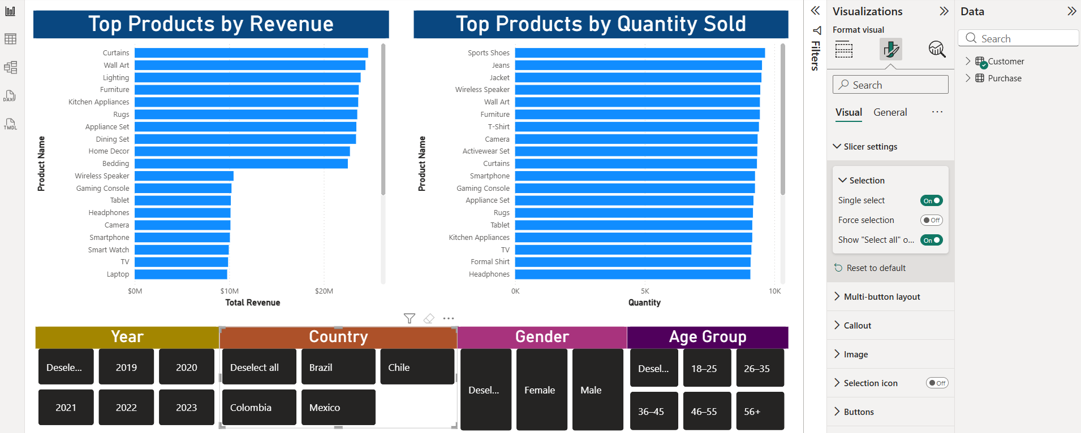
Product Analysis Overview
Designed to answer Objective 2
Mohamed Heriyanto Bin Jamal Mohamed - Power BI Business Analytics Capstone Project

Slide 26
Top Products by Revenue
Horizontal bar chart selected for ranking revenue-generating products
Chart type: Clustered Bar Chart
Reason: Product names are easier to read horizontally and bars support ranking from highest to lowest
Business value: Helps prioritise product promotion, inventory allocation and pricing strategy
Mohamed Heriyanto Bin Jamal Mohamed - Power BI Business Analytics Capstone Project

Slide 27
Top Products by Quantity Sold
Horizontal bar chart selected for ranking product demand
Chart type: Clustered Bar Chart
Reason: Quantity sold is a ranking metric; horizontal bars clearly compare product demand
Business value: Supports stock planning and demand forecasting
Mohamed Heriyanto Bin Jamal Mohamed - Power BI Business Analytics Capstone Project

Slide 28
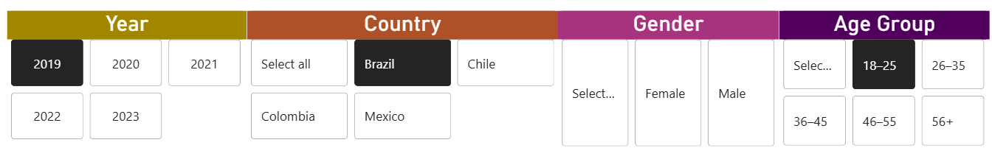
Product Dashboard Slicers
Interactive filters make product analysis flexible
Slicers used: Year, Country, Gender and Age Group
Reason: Users can analyse product performance for a selected market, customer profile or time period
Professional value: Reduces the need for separate static reports and supports self-service analytic
Mohamed Heriyanto Bin Jamal Mohamed - Power BI Business Analytics Capstone Project

Slide 29
DASHBOARD PAGE 4
Sales Trend
Orders and Revenue Over Time

Slide 30
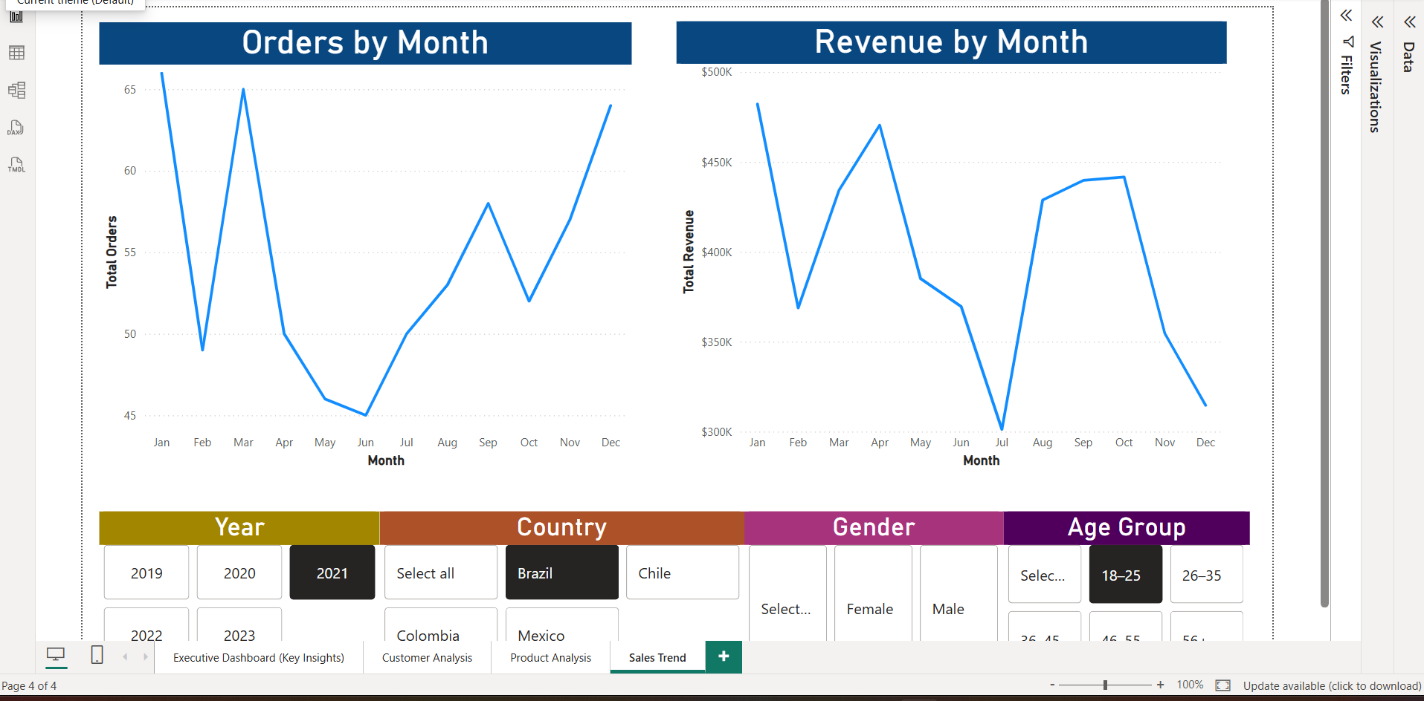
Sales Trend Overview
Designed to answer Objective 3
Mohamed Heriyanto Bin Jamal Mohamed - Power BI Business Analytics Capstone Project

Slide 31
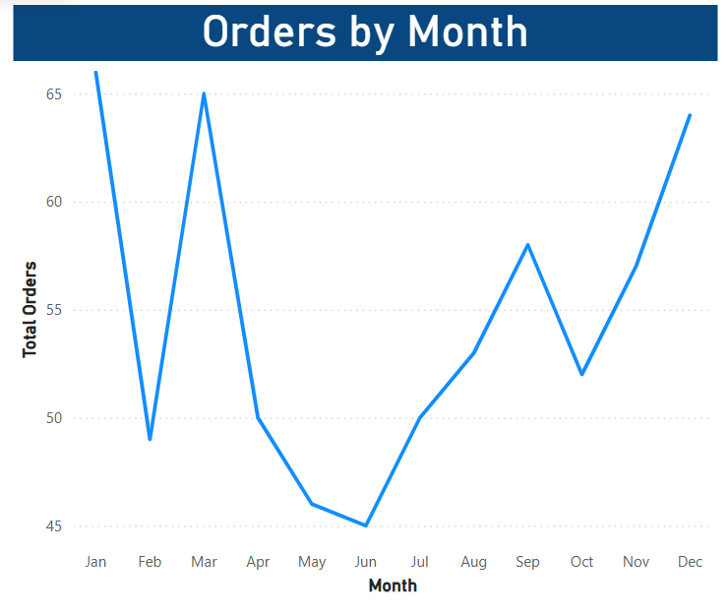
Orders by Month
Line chart selected for order trend analysis
Chart type: Line Chart
Reason: Order volume is time-based, and line charts are best for showing movement across months
Business value: Supports campaign scheduling, staffing and demand planning
Mohamed Heriyanto Bin Jamal Mohamed - Power BI Business Analytics Capstone Project

Slide 32
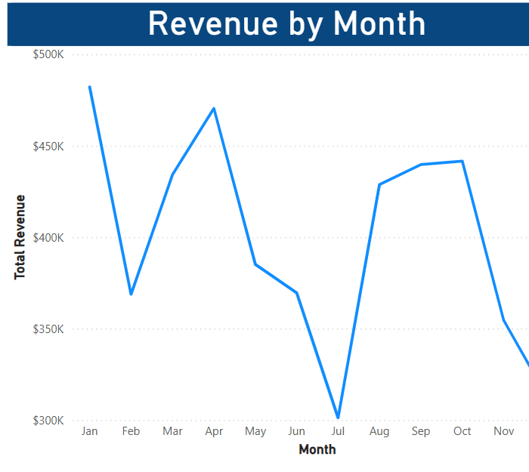
Revenue by Month
Line chart selected for revenue trend and seasonality analysis
Chart type: Line Chart
Reason: Monthly revenue is a time-series metric; a line chart reveals peaks, dips and patterns clearly
Business value: Supports forecasting, seasonal promotion planning and revenue monitoring
Mohamed Heriyanto Bin Jamal Mohamed - Power BI Business Analytics Capstone Project

Slide 33
Business Recommendations and Conclusion
Turning dashboard insights into management actions
1. Customer targeting
Evidence:
The High Income segment generates the highest revenue. Your age-group chart also identifies the strongest-performing age segment.
Recommendation:
Prioritise targeted campaigns, loyalty benefits and personalised offers for the highest-value income and age segments.
Mohamed Heriyanto Bin Jamal Mohamed - Power BI Business Analytics Capstone Project

Slide 34
Business Recommendations and Conclusion
Turning dashboard insights into management actions
2. Product Strategy
Evidence:
Curtains rank highest by total revenue, while Sports Shoes record the highest quantity sold. This shows that the product generating the most revenue is not necessarily the product purchased most frequently.
Recommendation:
Manage products using two complementary strategies:
Protect stock availability and profit margins for high-revenue products such as Curtains.
Use promotions, bundles and repeat-purchase campaigns for high-volume products such as Sports Shoes.
Why this insight is important:
This is one of the strongest findings in the dashboard because it compares product value and product demand. It helps management make better decisions about inventory, pricing and promotional planning.
Mohamed Heriyanto Bin Jamal Mohamed - Power BI Business Analytics Capstone Project

Slide 35
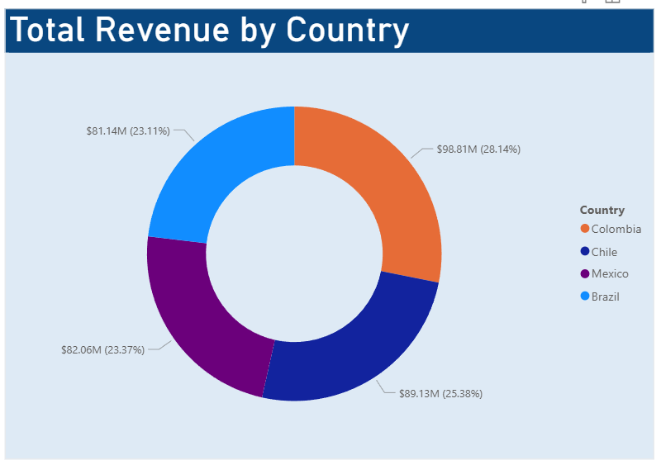
Business Recommendations and Conclusion
Turning dashboard insights into management actions
3. Country Focus
Evidence:
Colombia has the highest total revenue and the largest customer base in the dashboard.
Recommendation:
Protect the company’s position in Colombia through retention campaigns, while using targeted promotions to develop opportunities in Chile, Mexico and Brazil.
Mohamed Heriyanto Bin Jamal Mohamed - Power BI Business Analytics Capstone Project

Slide 36
Business Recommendations and Conclusion
Turning dashboard insights into management actions
4. Sales Planning
Evidence:
The monthly charts show noticeable changes in both orders and revenue throughout the year.
Recommendation:
Use monthly patterns to plan inventory, staffing and promotional campaigns before expected peak periods.
Mohamed Heriyanto Bin Jamal Mohamed - Power BI Business Analytics Capstone Project

Slide 37
5. Dashboard Monitoring
Recommendation:
Management should review Total Revenue, Total Orders, Total Customers and Average Order Value regularly. The slicers should be used to nvestigate performance by year, country, gender and age group.
Business Recommendations and Conclusion
Turning dashboard insights into management actions
THE END
Mohamed Heriyanto Bin Jamal Mohamed - Power BI Business Analytics Capstone Project

